Slide 1
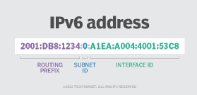
Let No -25 and 26 IPV6 - Addressing

Slide 2
What is IPv6 ?
Internet Protocol version 6 (IPv6) is the advance version of the Internet Protocol (IP) after IPV4.
It is also called a communications protocol that provides an identification and location system for computers on networks and routes traffic across the Internet.
The devices are assigned unique IP addresses for identification and location definition.

Slide 3
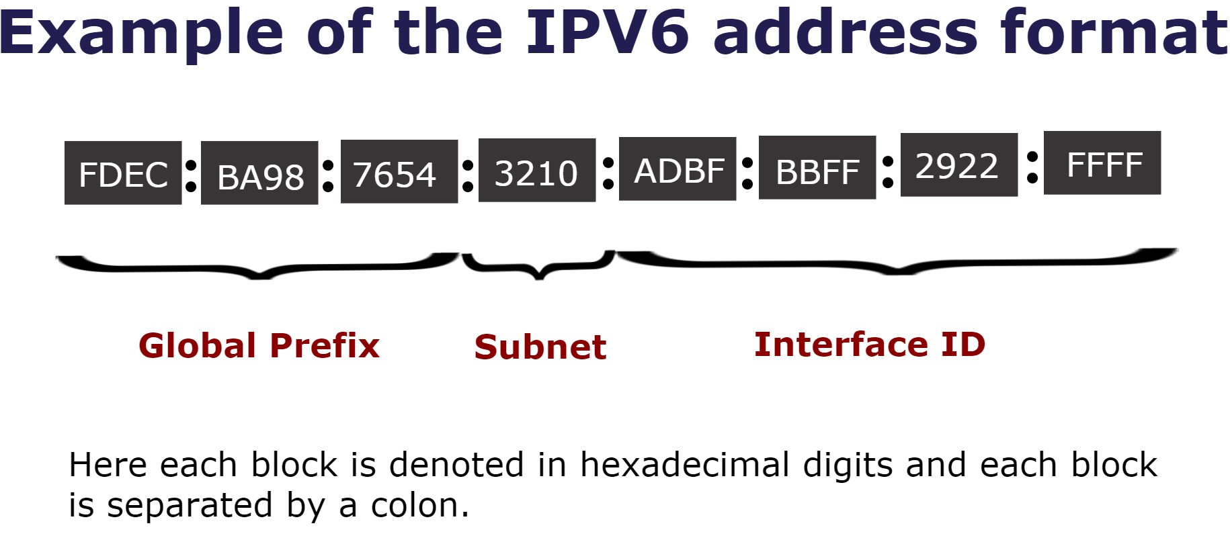

Slide 4
IPV6 Address Representation.
The IPv6 address is 128 bits long and is arranged in eight groups, each of which is 16 bits. Each group is expressed as four hexadecimal digits and the groups are separated by colons.
An example of a full IPv6 address could be:
FE80:CD00:0000:0CDE:1257:0000:211E:729C

Slide 5
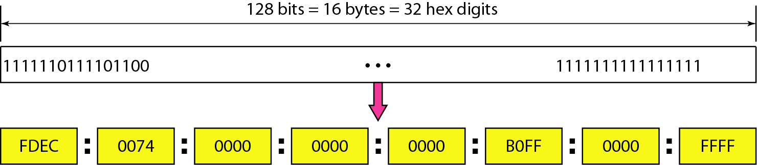
IPv6 address in binary and hexadecimal colon notation.

Slide 6
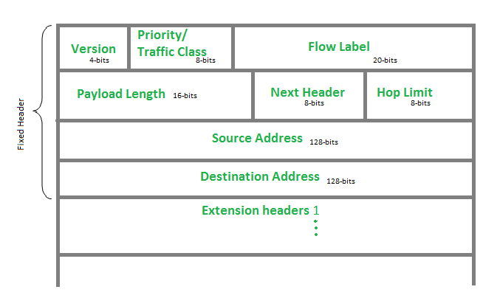
IPV6 Header Format

Slide 7
Description of IPV6 format.
Version (4-bits): Indicates the version of Internet Protocol which contains bit sequence 0110.
2. Traffic Class (8-bits): The Traffic Class field indicates the class or priority of the IPv6 packet which is similar to the Service Field in the IPv4 packet. It helps routers to handle the traffic based on the priority of the packet. If congestion occurs on the router then packets with the least priority will be discarded.

Slide 8
3. Flow Label (20-bits): -
The Flow Label field is used by a source to label the packets belonging to the same flow in order to request special handling by intermediate IPv6 routers, such as non-default quality of service or real-time service. In order to distinguish the flow, an intermediate router can use the source address, destination address, and flow label of the packets. Between a source and destination, multiple flows may exist because many processes might be running at the same time. Routers or Hosts that do not support the functionality of the flow label field and for default router handling, the flow label field is set to 0.

Slide 9
4. Payload Length (16-bits):-
In computing, a payload is the carrying capacity of a packet or other transmission data unit. It is a 16-bit (unsigned integer) field, that indicates the total size of the payload which tells routers about the amount of information a particular packet contains in its payload.
5. Next Header (8-bits): Next Header indicates the type of extension header(if present) immediately following the IPv6 header. Whereas In some cases it indicates the protocols contained within upper-layer packets, such as TCP, and UDP.
6. Hop Limit (8-bits): Hop Limit field is the same as TTL in IPv4 packets. It indicates the maximum number of intermediate nodes IPv6 packet is allowed to travel. Its value gets decremented by one, by each node that forwards the packet and the packet is discarded if the value decrements to 0.

Slide 10
7. Source Address (128-bits): Source Address is the 128-bit IPv6 address of the original source of the packet.
8. Destination Address (128 bits): The destination Address field indicates the IPv6 address of the final destination(in most cases). All the intermediate nodes can use this information in order to correctly route the packet.
9. Extension Headers: In order to rectify the limitations of the IPv4 Option Field, Extension Headers are introduced in IP version 6. The extension header mechanism is a very important part of the IPv6 architecture.

Slide 11
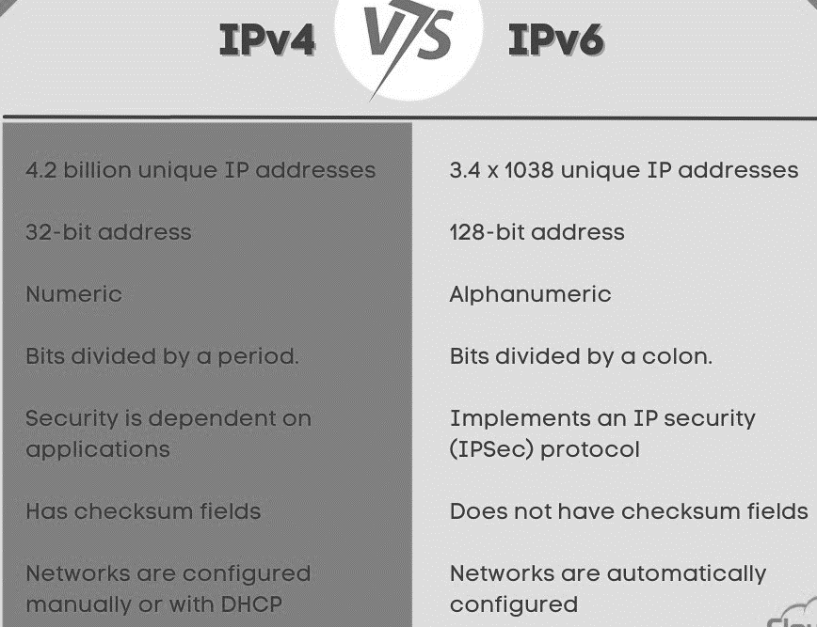

Slide 12
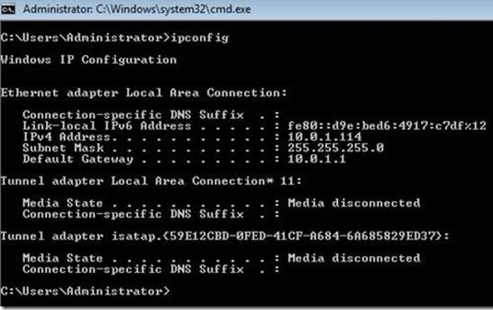
How to check the IPV6 version on a PC?

Slide 13


